Slide 1
Graph Traversal
(DFS)
C++
C++ programming language

Slide 2



Roadmap of Learning Outcome 1 & 2
Algorithms P1:
Complete Search
Greedy Algorithm
Divide & Conquer[merge-BS]
Dynamic Programming
Data Structure P1:
Arrays
Pointers
Vectors
Stack
Queue
Circular Queue
Linked-list
Doubly linked-list
Data Structure P2:
Graph
Trees
Complexity Analysis of Data Structure & Algorithms
Algorithms P2:
Graph Traversal
Greedy
Backtracking

Slide 3
TABLE OF CONTENTS
01
02
Intro to Graph Traversal Algorithms
Depth-First Search (DFS)
03
DFS Implementation
04
05
DFS Applications
Conclusion

Slide 4
01
Intro to Graph Traversal Algorithms

Slide 5
Intro to Graph Traversal Algorithms
01
Having discussed the essential terminology and various representations of graphs, let’s delve into Graph Traversal.

Slide 6
Intro to Graph Traversal Algorithms
01
Having discussed the essential terminology and various representations of graphs, let’s delve into Graph Traversal.
Graph Traversal is a systematic technique for visiting or examining each vertex and edge in the graph, helping us solve problems like:

Slide 7
Intro to Graph Traversal Algorithms
01
Having discussed the essential terminology and various representations of graphs, let’s delve into Graph Traversal.
Graph Traversal is a systematic technique for visiting or examining each vertex and edge in the graph, helping us solve problems like:
Checking if a path exists between two nodes.

Slide 8
Intro to Graph Traversal Algorithms
01
Having discussed the essential terminology and various representations of graphs, let’s delve into Graph Traversal.
Graph Traversal is a systematic technique for visiting or examining each vertex and edge in the graph, helping us solve problems like:
Checking if a path exists between two nodes.
Finding the shortest path.

Slide 9
Intro to Graph Traversal Algorithms
01
Having discussed the essential terminology and various representations of graphs, let’s delve into Graph Traversal.
Graph Traversal is a systematic technique for visiting or examining each vertex and edge in the graph, helping us solve problems like:
Checking if a path exists between two nodes.
Finding the shortest path.
Detecting Cycles.

Slide 10
Intro to Graph Traversal Algorithms
01
Two common algorithms for graph traversal are:
Depth-First Search (DFS).
Breadth-First Search (BFS).

Slide 11
02
Depth - First Search (DFS)

Slide 12
02
Depth-First Search (DFS)
1
Depth-First Search (DFS) is a traversal algorithm that starts at a specific vertex and recursively explores all its adjacent vertices.
It dives deeper into the graph, exploring a vertex’s descendants before backtracking.
When all neighbors of the current vertex have been visited, the algorithm backtracks to the previous vertex and resumes the process.
2
4
5
7
3
8
6

Slide 13
02
Depth-First Search (DFS)
1
Depth-First Search (DFS) is a traversal algorithm that starts at a specific vertex and recursively explores all its adjacent vertices.
It dives deeper into the graph, exploring a vertex’s descendants before backtracking.
When all neighbors of the current vertex have been visited, the algorithm backtracks to the previous vertex and resumes the process.
2
4
5
7
3
8
6

Slide 14
02
Depth-First Search (DFS)
1
Depth-First Search (DFS) is a traversal algorithm that starts at a specific vertex and recursively explores all its adjacent vertices.
It dives deeper into the graph, exploring a vertex’s descendants before backtracking.
When all neighbors of the current vertex have been visited, the algorithm backtracks to the previous vertex and resumes the process.
2
4
5
7
3
8
6

Slide 15
02
Depth-First Search (DFS)
1
Depth-First Search (DFS) is a traversal algorithm that starts at a specific vertex and recursively explores all its adjacent vertices.
It dives deeper into the graph, exploring a vertex’s descendants before backtracking.
When all neighbors of the current vertex have been visited, the algorithm backtracks to the previous vertex and resumes the process.
2
4
5
7
3
8
6

Slide 16
02
Depth-First Search (DFS)
1
Depth-First Search (DFS) is a traversal algorithm that starts at a specific vertex and recursively explores all its adjacent vertices.
It dives deeper into the graph, exploring a vertex’s descendants before backtracking.
When all neighbors of the current vertex have been visited, the algorithm backtracks to the previous vertex and resumes the process.
2
4
5
7
3
8
6

Slide 17
02
Depth-First Search (DFS)
1
Depth-First Search (DFS) is a traversal algorithm that starts at a specific vertex and recursively explores all its adjacent vertices.
It dives deeper into the graph, exploring a vertex’s descendants before backtracking.
When all neighbors of the current vertex have been visited, the algorithm backtracks to the previous vertex and resumes the process.
2
4
5
7
3
8
6

Slide 18
02
Depth-First Search (DFS)
1
Depth-First Search (DFS) is a traversal algorithm that starts at a specific vertex and recursively explores all its adjacent vertices.
It dives deeper into the graph, exploring a vertex’s descendants before backtracking.
When all neighbors of the current vertex have been visited, the algorithm backtracks to the previous vertex and resumes the process.
2
4
5
7
3
8
6

Slide 19
02
Depth-First Search (DFS)
1
Depth-First Search (DFS) is a traversal algorithm that starts at a specific vertex and recursively explores all its adjacent vertices.
It dives deeper into the graph, exploring a vertex’s descendants before backtracking.
When all neighbors of the current vertex have been visited, the algorithm backtracks to the previous vertex and resumes the process.
2
4
5
7
3
8
6

Slide 20
02
Depth-First Search (DFS)
1
Depth-First Search (DFS) is a traversal algorithm that starts at a specific vertex and recursively explores all its adjacent vertices.
It dives deeper into the graph, exploring a vertex’s descendants before backtracking.
When all neighbors of the current vertex have been visited, the algorithm backtracks to the previous vertex and resumes the process.
2
4
5
7
3
8
6

Slide 21

Depth-First Search (DFS)
02
In this video let's see how we can build our own graph traversal method and show how it intuitively leads to core idea of DFS.

Slide 22
03
DFS Implementation

Slide 23
DFS Implementation - Steps
03
Starting Point: Select a starting vertex (let it be $U$).

Slide 24
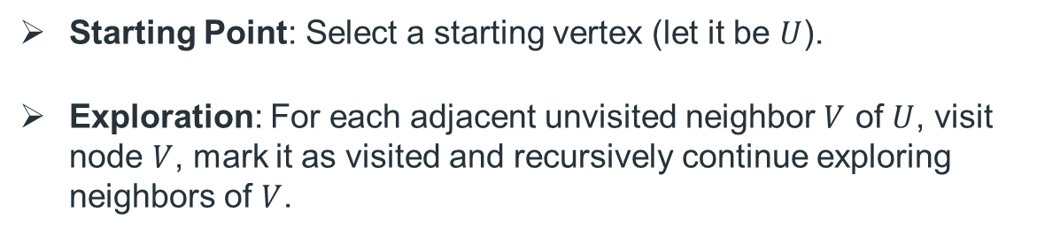
DFS Implementation - Steps
03
Starting Point: Select a starting vertex (let it be $U$).
Exploration: For each adjacent unvisited neighbor $V$ of $U$, visit node $V$, mark it as visited and recursively continue exploring neighbors of $V$.

Slide 25
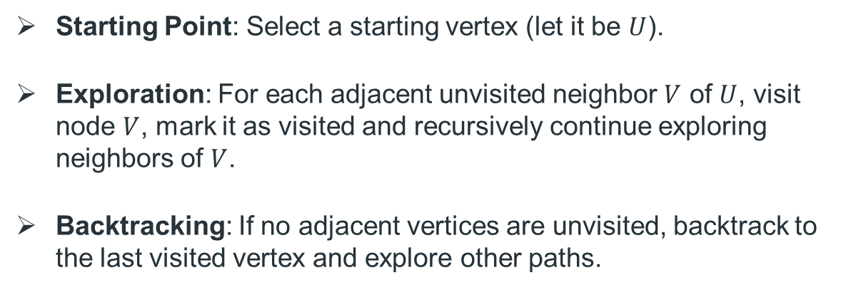
DFS Implementation - Steps
03
Starting Point: Select a starting vertex (let it be $U$).
Exploration: For each adjacent unvisited neighbor $V$ of $U$, visit node $V$, mark it as visited and recursively continue exploring neighbors of $V$.
Backtracking: If no adjacent vertices are unvisited, backtrack to the last visited vertex and explore other paths.

Slide 26
DFS Implementation - Steps
03
Starting Point: Select a starting vertex (let it be $U$).
Exploration: For each adjacent unvisited neighbor $V$ of $U$, visit node $V$, mark it as visited and recursively continue exploring neighbors of $V$.
Backtracking: If no adjacent vertices are unvisited, backtrack to the last visited vertex and explore other paths.

Slide 27
DFS Implementation - Pseudocode
03
The most suitable approach to apply these steps is Recursion.

Slide 28
DFS Implementation - Pseudocode
03
The most suitable approach to apply these steps is Recursion.
Pseudocode:
DFS(u):
mark u as visited
for each neighbor v of u do:
if v is not visited then:
DFS(v)

Slide 29
Let us now see how we can implement DFS in C + +

Slide 30
DFS Implementation – Code
03
vector<vector<int>> adj; vector<bool> visited; void dfs(int u) {...} int main() { int nodes, edges; cin >> nodes >> edges; // assign resizes the container and fills it with a value
// resize the adj list and initialize with empty vectors adj.assign(nodes + 1, {});
// resize the visited array and initialize with false visited.assign(nodes + 1, false); for (int i = 0; i < edges; ++i) { int from, to; cin >> from >> to;
// add edges adj[from].push_back(to); adj[to].push_back(from); } dfs(1); }

Slide 31
DFS Implementation – Code
03
vector<vector<int>> adj; vector<bool> visited; void dfs(int u) {
visited[u] = true; cout << u << " "; for (int neig: adj[u]) { if (!visited[neig]) dfs(neig); }
} int main() { int nodes, edges; cin >> nodes >> edges; adj.assign(nodes + 1, {}); visited.assign(nodes + 1, false); for (int i = 0; i < edges; ++i) {...} // add edges dfs(1); }

Slide 32
Example
1
Input:
5 5
1 4
4 5
4 3
3 5
3 2
The first line is the number of nodes (5) and edges (5), respectively.
The next 5 lines represents the edges. Each of them contains two integers u & v, meaning that there is an edges between u and v.
4
5
3
2

Slide 33
Example
1
Output:
4
5
3
2

Slide 34
Example
1
Output:
4
1
5
3
2

Slide 35
Example
1
Output:
4
1 4
5
3
2

Slide 36
Example
1
Output:
4
1 4 5
5
3
2

Slide 37
Example
1
Output:
4
1 4 5 3
5
3
2

Slide 38
Example
1
Output:
4
1 4 5 3 2
5
3
2

Slide 39
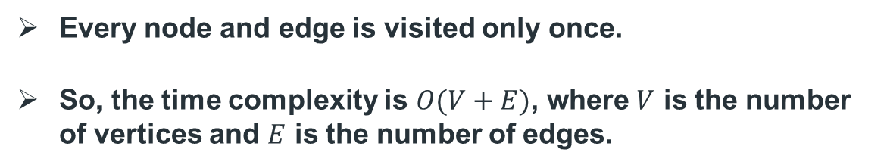
DFS Time Complexity
Every node and edge is visited only once.
So, the time complexity is $O(V+E)$, where $V$ is the number of vertices and $E$ is the number of edges.

Slide 40
04
DFS Applications

Slide 41
04
DFS Applications
Count the number of Connected Components in an undirected graph.
Cycle Detection in undirected/directed graphs.
Topological Sorting.

Slide 42
Problem 1
You are given an undirected graph.
Count the number of connected components and print it.

Slide 43
Problem 2
You are given an undirected graph. You need to check if the graph contains any cycles.
Print “Cyclic” If any cycles were detected, otherwise print “Acyclic”.

Slide 44
Problem 3
You are given a directed graph. You need to check if the graph contains any cycles.
Print “Cyclic” If any cycles were detected, otherwise print “Acyclic”.

Slide 45
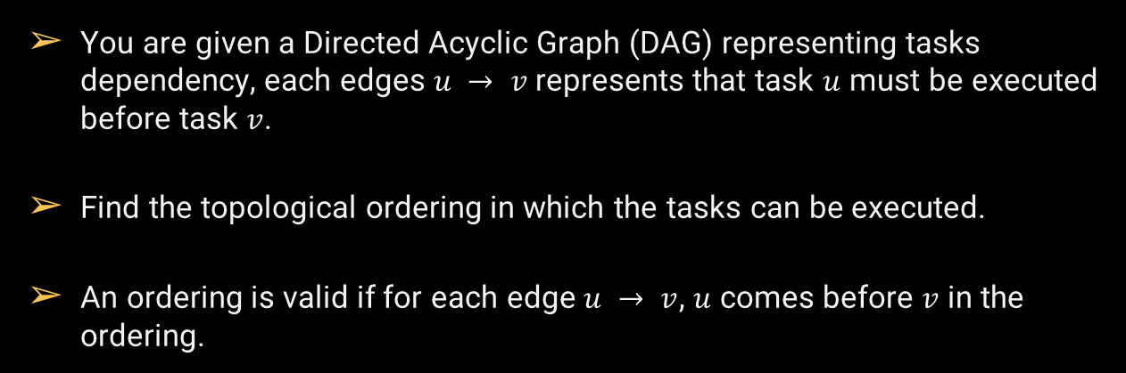
Problem 4
Problem Link: Ordering Tasks
You are given a Directed Acyclic Graph (DAG) representing tasks dependency, each edges $u → v$represents that task $u$ must be executed before task $v$.
Find the topological ordering in which the tasks can be executed.
An ordering is valid if for each edge $u → v$, $u$ comes before $v$ in the ordering.

Slide 46
THANK
YOU!

